Slide 1
Name:- Vinit Amul Pol Class:-TYIT Guide Name:-Trupti Kulkarni
Topic :- Smart Traffic Management System with Real Time Analysis

Slide 2
Index
Aim
Requirement
Hardware and software
Language & platform
How it work & specialty
Advantages and Use
Conclusion
References

Slide 3
Aim of project
The purpose of designing traffic management system for globally increases accident in day to day life this project will help to maintaining the traffic rules and regulation.
The first traffic light was invented in London in 1980’s to control cause of horse carriages it was operated manually works but today it work on electricity very smooth movement traffic This system works like clockwork with the light changes at regular interval The main purpose of system allocat each road based on amount of traffic The amount of traffic on signal classified under three levels low, medium and high these level are determine by Arduino Uno based on inputs received from the Ultrasonic sensor and camera.

Slide 4
Requirement
Cardboard
Traffic signal light’s
Arduino Uno
Ultrasonic sensor
Toy Vehicle
Jumper wire M2M &M2F
BreadBoard
Icecream Stick

Slide 5
Hardware and Software
The project will work on the Arduino Uno is an open sources microcontroller board based on the Microchip AT mega 328P microcontroller and developed by Arduino.cc The board has 14 digital I/O pins (six capable of PWM output), 6 analog I/O pins, and is programmable with the Arduino IDE (Integrated Development Environment), via a type B USB cable The word “Uno" means "one" in Italian and was chosen to mark the initial release of Arduino software The Uno board is the first in a series of USB-based Arduino boards And Most importantly use Ultrasonic.
Sensor which can Count the Numbers of vehicle an make distance between each vehicle that reduces the accident in traffic It’s all about Hardware Part

Slide 6
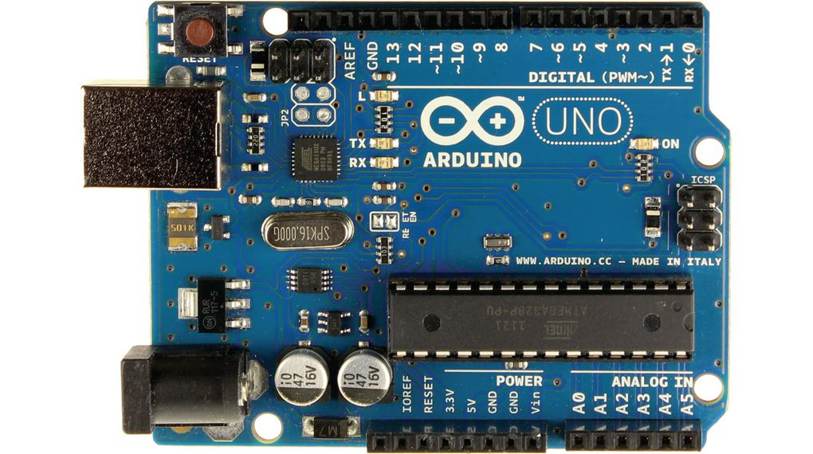
Arduino Uno

Slide 7
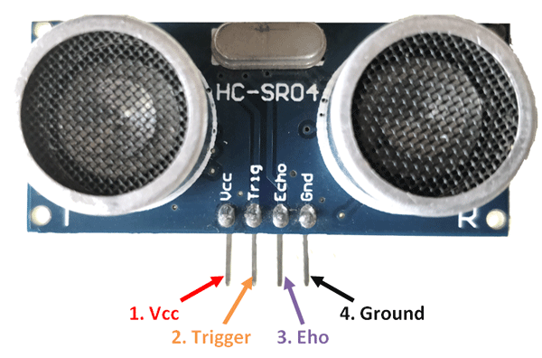
Ultrasonic sensor

Slide 8
Software
This particular Project will run program & execute under Arduino IDE (Integrated Development Environment ) Shell

Slide 9
Language and platform
We are using very simple Language for the project that is user friendly easy code and find out error if occure i.e Arduino Uno.
The Arduino Uno can run on any platform such as Windows, Linux, MacOS, etc are there

Slide 10
How it work
The system is used with allotted timing in traffic signal based on level of traffic on land it calculate level of traffic on each road is divided onto three section which is programmed by Arduino uno . Each section house an ultrasonic sensor to determine the present obstacle by finding the distance taken for transmitted signals to be received In addition to find the level of traffic in the area based on vehicle present in section level of traffic classified as low , medium , High
The Arduino uno determines the level of traffic and allots timing to the traffic light indicators which are the red, yellow, and green LED’s the ultrasonic sensors determine the level of traffic. As shown in the figure, the densities on Road 2 way are respectively low, medium, no traffic and high. The corresponding values displayed on the Arduino shell terminal confirm that the sensors read the same values.

Slide 11
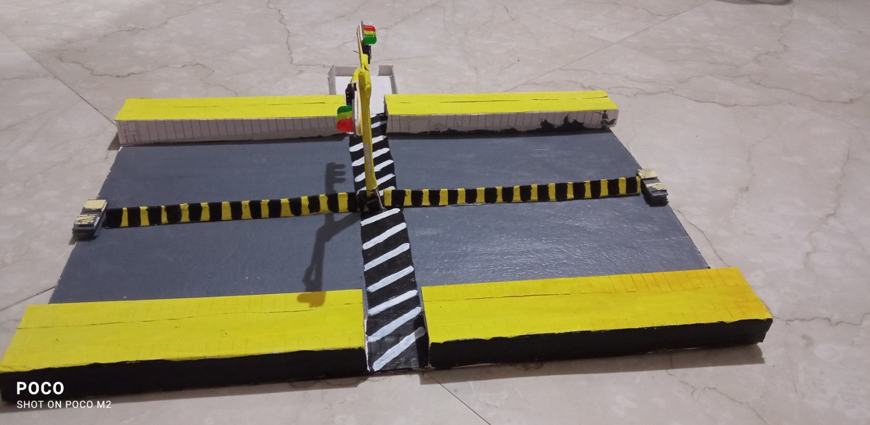

Slide 12
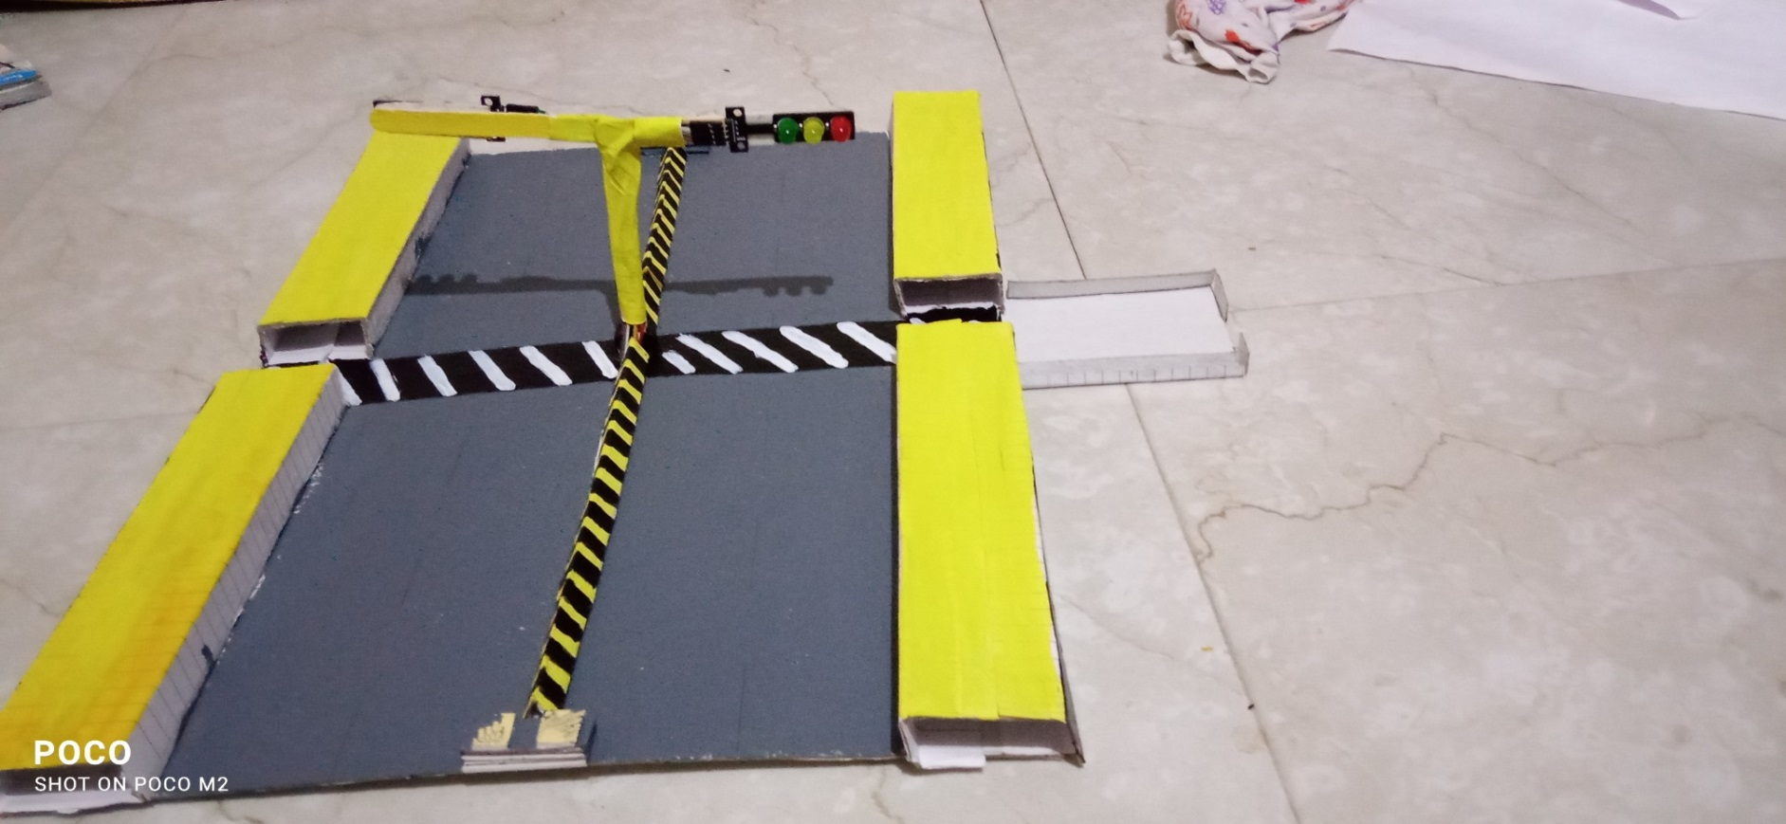

Slide 13
Specialty
Special for future scope This project still has space for improvement and can be extended by displaying traffic data in an application that can be accessed by the public.
In addition the system can be made more efficient by using a camera with higher resolution or by replacing the HCSR04 ultrasonic sensors with industrial grade sensors that serve the same purpose.
Further changes can also be made to the system that permits emergency vehicles to be given the highest priority in any situation

Slide 14
Advantage of project
This Arduino Uno Smart Traffic system is a very efficient system for managing Traffics, especially when the Ambulance is on the road. So that Traffic management system becomes easy. And many more are there since it is so useful in day to day life.

Slide 15
Conclusion :-
1.This research presents an effective solution for rapid growth of traffic flow particularly in big cities which is increasing day by day and traditional systems have some limitations as they fail to manage current traffic effectively.
2.Keeping in view the state of the art approach for traffic management systems a smart traffic management system is proposed to control road traffic situations more efficiently and effectively.
3. It changes the signal timing intelligently according to traffic density on the particular roadside and regulates traffic flow by communicating with local server more effectively than ever before.
4.The decentralized approach makes it optimized and effective as the system works even if a local server or centralized server has crashed. The centralized server communicates the nearest rescue department in case of an emergency situation which provides timely human safety.

Slide 16
References 1. W. S. Associate, "Transportation and Economy Report," MDOT State Long Range Transportation Plan, Karachi, 2007. 2. K. S. D. M. R. B. Patan Rizwan, "Realtime Smart Traffic Management System for Smart Cities by Using Internet of Things and Big Data," in International Conference on Emerging Technological Trends [ICETT], Kollam, 2016 3. C. S. D. L. T. Authority, "Annual Vehicle Statistics," Annual Vehicle Statistics 2015, Karachi, 2015.

Slide 17
Thank you

